Slide 1
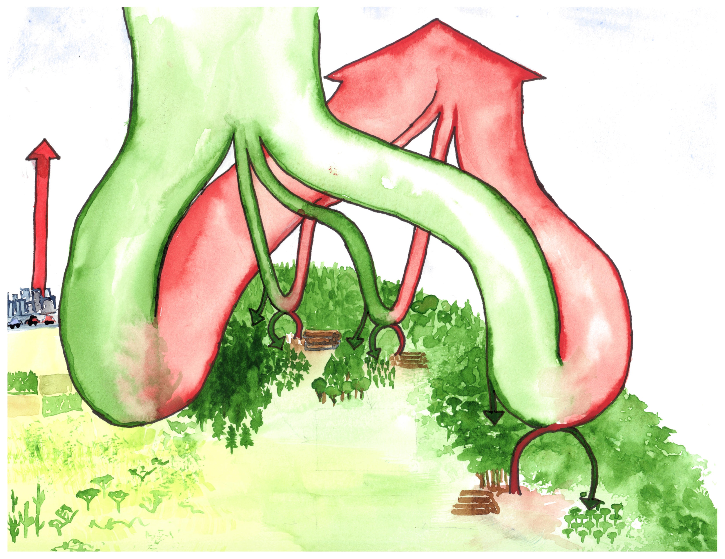
atmosphere
~800
gross primary production
122
Fluxes Gt C yr⁻¹
Stocks Gt C
respiration + fire
fossil fuels
+9.4
63
8
10
41
boreal forests
temperate forests
non-forest
biomass 54
biomass 47
tropical forests
-0.5
-0.8
intact forest sink
-2.3
-1.0 – 1.4
biomass
262-229
biomass
31
deforestation + degradation
+0.9 - 2.8
regrowth
-1.7
net terrestrial sink
-1.2 - 1.3
net deforestation
+1.1
Notes:
Most recent estimates from each source

